Slide 1
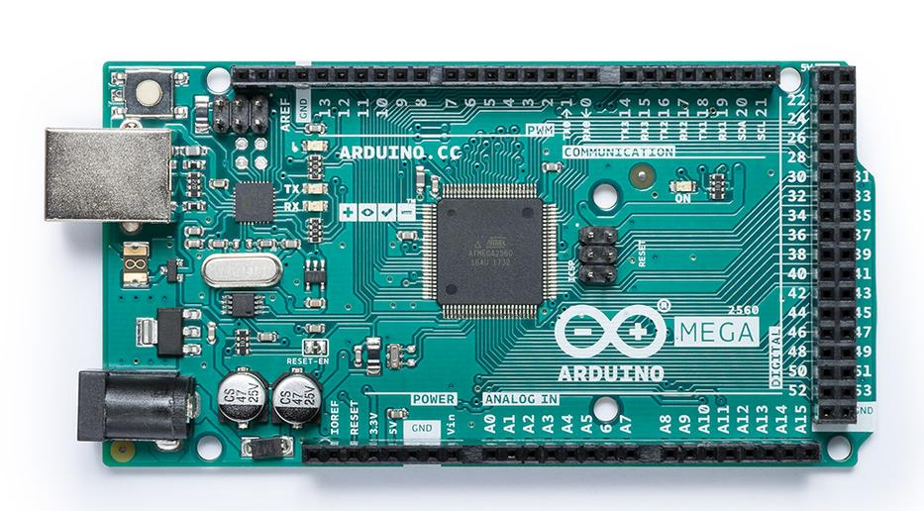
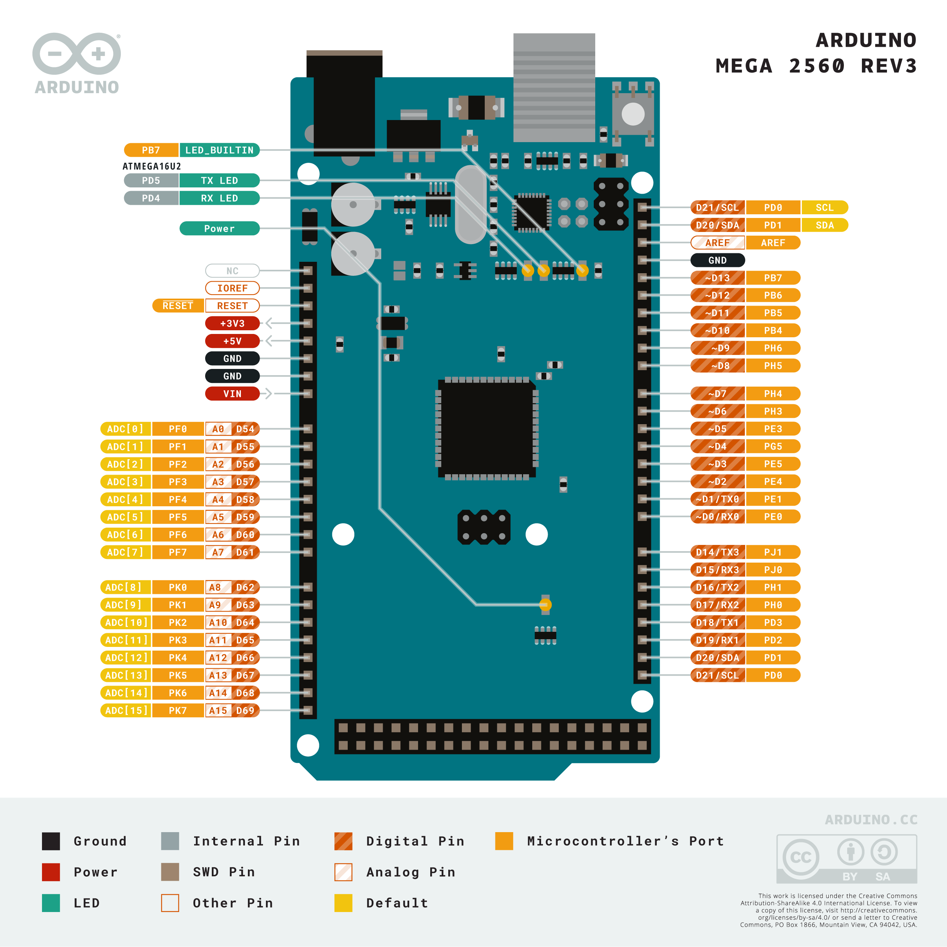
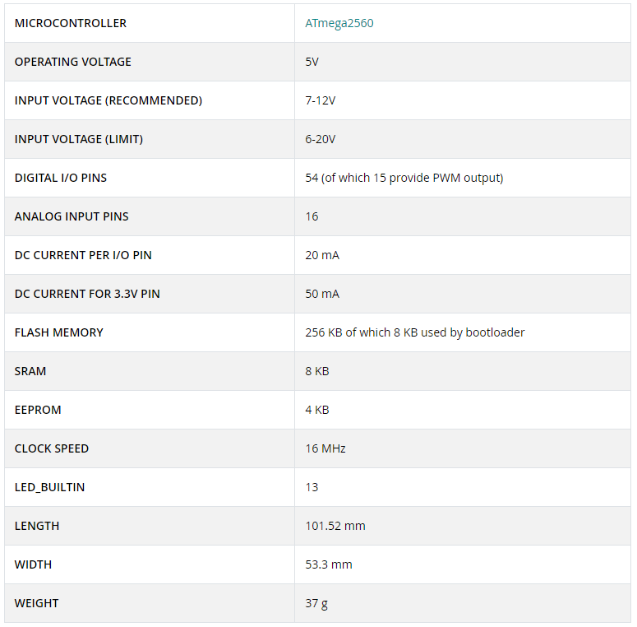

Slide 2



























$$5V$$
Computer
$$USB$$
$$Serial$$
$$D0÷D1$$
$$5V$$
$$12$$
Sensors
(1 End stroke per motor)
$$5V$$
$$D22÷D45$$
Arduino
Mega
$$3$$
$$5V$$
$$24V$$
$$3$$
$$24V$$
Optocoupler + Relay
(3 rows of 4 motors)
Actuators
(12 DC Motors)
$$D46÷D48$$
Interrupts
$$D18÷D20$$
$$D2$$
$$D3$$
$$D4$$
$$EN$$
$$24V$$
$$Start$$
$$Stop$$
$$3$$
$$5V$$
$$24V$$
$$3$$
Optocoupler
(1 each line)
Current Generator
$$5V$$
Datalogger
$$3$$
$$ERR$$
$$ERR$$
$$5V$$
$$24V$$
Optocoupler
(1 each line)
$$5V$$
Emergency Button
$$Stop$$

Slide 3
BOM
Item | QTY | Datasheet
Arduino Mega | 1
Motors | 12
End Stroke | 24
DPDT Relays | 3
Optocoupler | 7
Emergency Button | 1

Slide 4
Inputs & Outputs
*Optional
Component | Arduino Input | Arduino Output
Actuator |  | Can_move Move_forward Move_backward
End stroke | Is_close | -
Datalogger | Is_allarm | -
Generator | Test_end Test_in_progess Test_stopped | Start_cycle Stop_cycle Enable
Emergency switch | Is_pressed | -
Door switch | Door_closed
User interface | Start_test Stop_test End_test | -

Slide 5
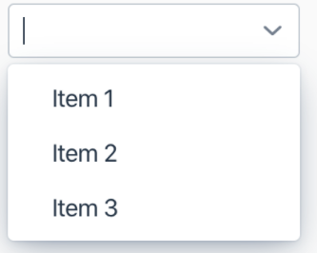
User interface
Test type
Test status: In progress
Mating test
High load
Annex LL
Current cycle : 12/248
Cycle Phase : Current On
Test cycles
248
Phase timer: 0:27:15
Ton[h]
2
Toff[h]
1
Cycle duration: 3h
Test duration: 42 days
Start time : 30/11/2021 15:06
End time : 11/01/2022 17:06
Start test
Stop test

